Slide 1
Học máy trong phân tích kinh doanh
Bài Học
Microsoft: GUI
Giảng viên:
TS. Trần Duy Thanh
Email: thanhtd@uel.edu.vn
Blog: https://tranduythanh.com

Slide 2
Mục tiêu bài học
Development Graphic User Interface with C#
Design GUI as well with controls:
Form Label Textbox Button Checkbox RadioButton Picturebox DatetimePicker Listbox & Combobox
RichTextbox
ListView
DataGridView
TreeView
Chart

Slide 3
History
Console/cmd
Windows Form
WPF
Universal
Microsoft technology for visualization and interaction
Visual Studio tool:
https://tranduythanh.com/2022/02/08/huong-dan-tai-cai-dat-va-su-dung-visual-studio-2022/

Slide 4
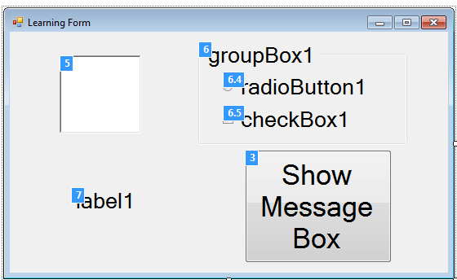
Windows Form
Represents a window or dialog box that makes up an application’s user interface

Slide 5
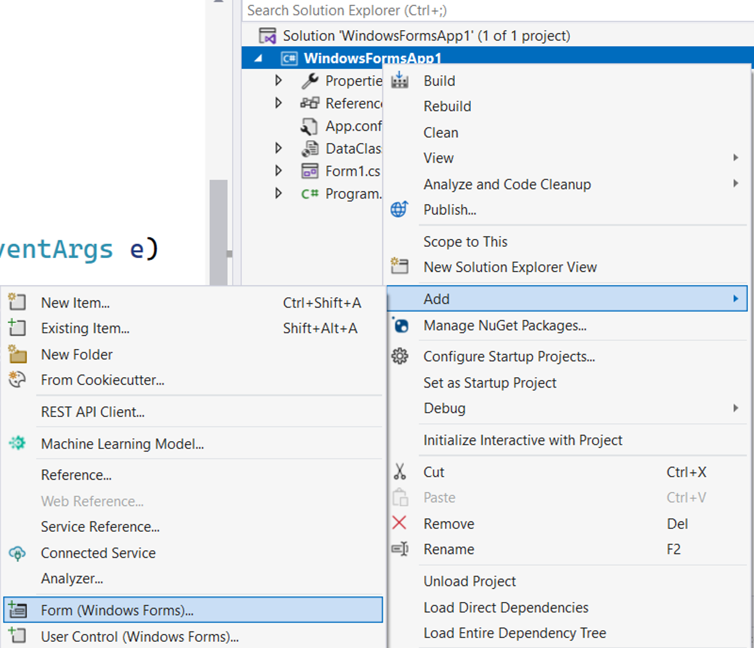
Windows Form
Create Form
Right Click on Project Name
Choose Add Item
Choose Form (Windows Forms)…

Slide 6
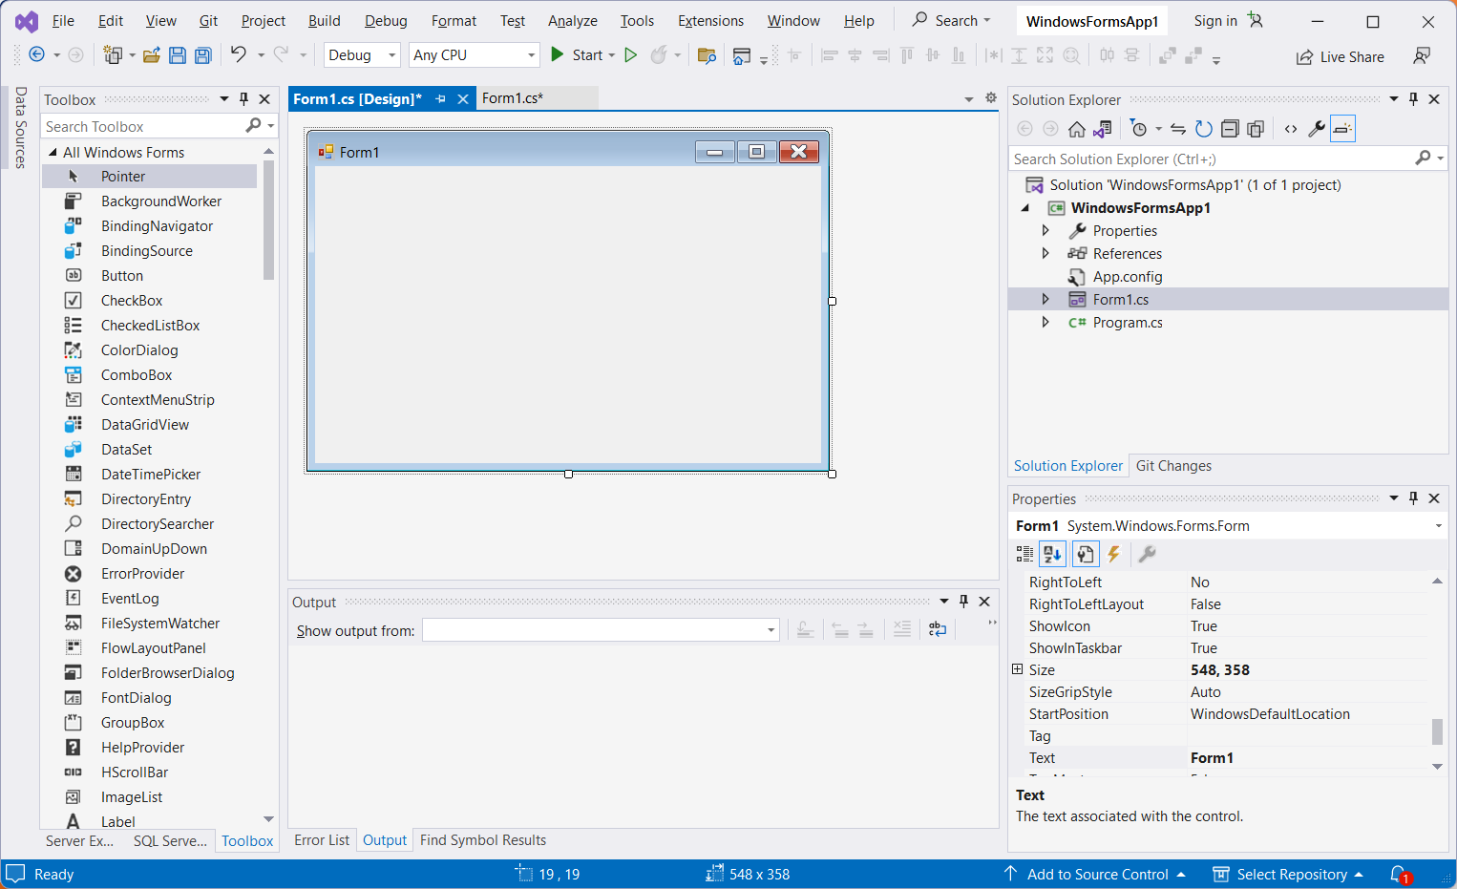
Windows Form

Slide 7
Windows Form
Properties | Description
Text | Gets or sets the text associated with this control
Name | Gets or sets the Name
Size | Gets or sets the size of the form.
WindowState | Gets or sets the form's window state. Normal; Minimized; Maximized
Font | Gets or sets the font of the text displayed by the control
StartPosition | Gets or sets the starting position of the form at run time. Manual, CenterScreen, WindowsDefaultLocation, WindowsDefaultBounds, CenterParent
TopMost | Gets or sets a value indicating whether the form should be displayed as a topmost form.

Slide 8
Windows Form
Properties | Description
FormBorderStyle | Gets or sets the border style of the form: None, FixedSingle, Fixed3D, FixedDialog, Sizable, FixedToolWindow, SizableToolWindow
BackColor | Gets or sets the background color for the control
BackGroundImage | Gets or sets the background image displayed in the control
MainMenuStrip | Gets or sets the primary menu container for the form
ForceColor | Gets or sets the foreground color of the control
Cursor | Gets or sets the cursor that is displayed when the mouse pointer is over the control
Location | Gets or sets the Point that represents the upper-left corner of the Form in screen coordinates
Icon | Gets or sets the icon for the form.
Opacity | Gets or sets the opacity level of the form

Slide 9
Windows Form
Properties | Description
AcceptButton | Gets or sets the button on the form that is clicked when the user presses the ENTER key.
CancelButton | Gets or sets the button control that is clicked when the user presses the ESC key
DEMO
Windows Forms

Slide 10
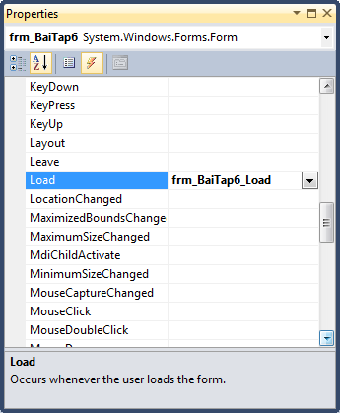
Windows Form
Popular Events
For Windows Forms & Another Controls

Slide 11
Windows Form
Properties | Description
Click | Occurs when the control is clicked. (Inherited from Control.)
DoubleClick | Occurs when the control is double -clicked. (Inherited from Control.)
Load | Occurs before a form is displayed for the first time.
FormClosing | Occurs before the form is closed.
FormClosed | Occurs after the form is closed.
KeyDown | Occurs when a key is pressed while the control has focus. (Inherited from Control.)
KeyPress | Occurs when a key is pressed while the control has focus. (Inherited from Control.)
KeyUp | Occurs when a key is released while the control has focus. (Inherited from Control.)

Slide 12
Windows Form
Properties | Description
MouseClick | Occurs when the control is clicked by the mouse. (Inherited from Control.)
MouseDoubleClick | Occurs when the control is double clicked by the mouse. (Inherited from Control.)
MouseDown | Occurs when the mouse pointer is over the control and a mouse button is pressed.(Control)
MouseEnter | Occurs when the mouse pointer enters the control.(Control)
MouseHover | Occurs when the mouse pointer rests on the control(Control)
MouseLeave | Occurs when the mouse pointer leaves the control. (Control)
MouseMove | Occurs when the mouse pointer is moved over the control. (Control)
MouseUp | Occurs when the mouse pointer is over the control and a mouse button is released.(Control)
MouseWheel | Occurs when the mouse wheel moves while the control has focus.(Control)

Slide 13
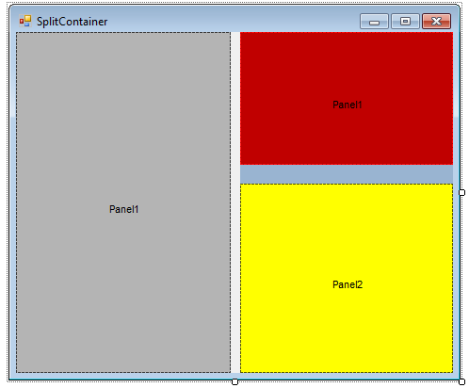
Panel & SplitContainer
The purpose of the Panel is to create areas so that we can arrange the controls on it to our liking, the controls will be grouped in the panel. You can move all controls inside by dragging the panel alone.
Panel and FlowLayoutPanel

Slide 14
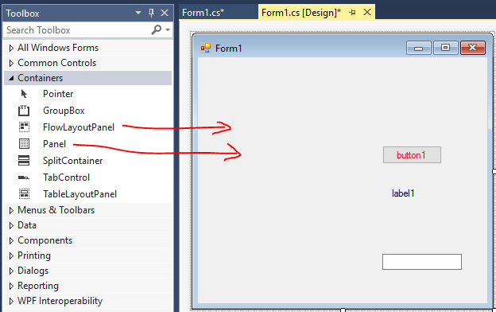
Panel & SplitContainer

Slide 15
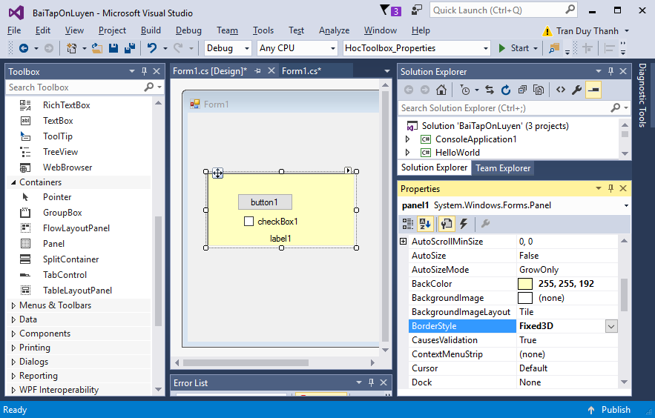
Panel & SplitContainer

Slide 16
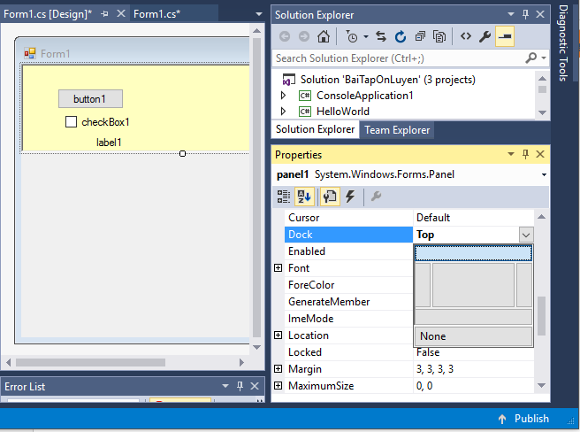
Panel & SplitContainer

Slide 17
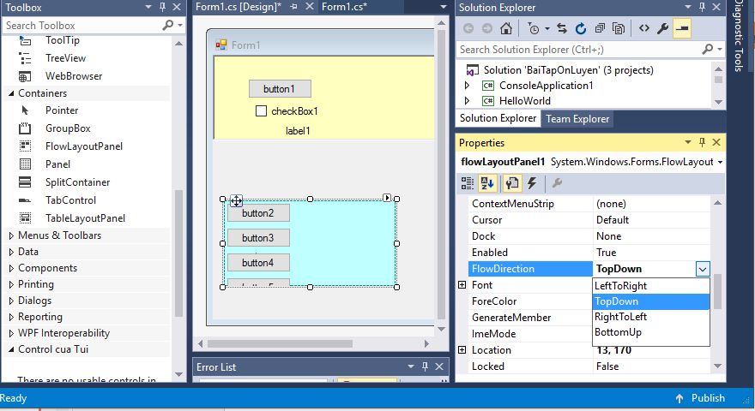
Panel & SplitContainer

Slide 18
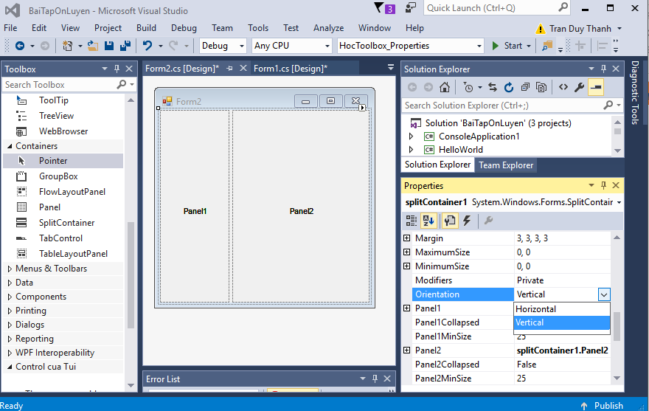
Panel & SplitContainer

Slide 19
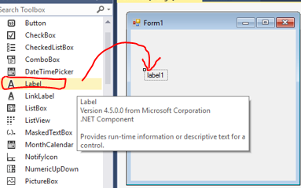
Label
Label is a control used to represent a string or text on the form.
Properties | Description
Name | Label name, usually starting with lbl
Text | The displayed text string
BackColor | Background color
ForeColor | Text color
Font | Font Format

Slide 20
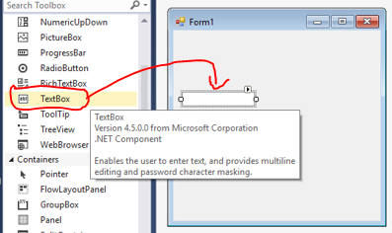
Textbox
TextBox is used as a place for users to enter information into the program
Properties | Description
Name | Textbox name, usually starting with txt
Text | The displayed text string
Enabled | Determine if the textbox is active (true) or not (false)
Multiline | If set to true, the content in the textbox is written in multiple lines
PasswordChar | Declare a replacement character when entering a password (eg '*')
ReadOnly | If set to true, the textbox is only readable, not allowed to edit the content

Slide 21
Demo
Design a Form to classify the GPA:
GPA | Classification | Color
4.00-3.67 | Excellent | Blue
3.66-3.00 | Very Good | Green
2.99-2.33 | Good | Purple
2.32-2.00 | Fair | Orange
Below 2.00 | Fail | Red

Slide 22
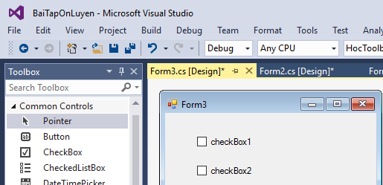
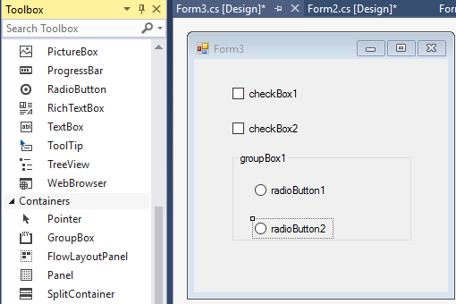
Checkbox & RadioButton
Checkbox allows on the user interface to be able to select multiple options.
RadioButton allows on the user interface to select only 1 option. Must combine with GroupBox to group RadioButtons (required)
Properties | Description
Name | Control name, usually starting with chk (CheckBox) and rad, rbtn (RadioButton)
Text | Control title, usually located to the right of that control
Checked | Control state, true is currently selected.

Slide 23
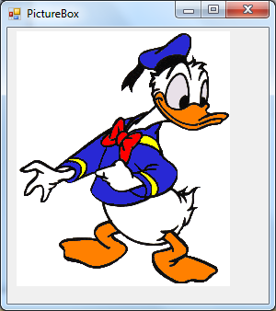
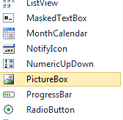
Picturebox
PictureBox is used to display images on the interface
Properties | Description
Name | Control name, usually starting with pic
BackgroundImage | Used to display images
BackgroundImageLayout | Set the image appearance
Image | Used to display images
SizeMode | Set the image appearance

Slide 24
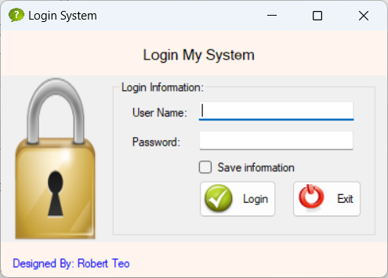
Demo

Slide 25
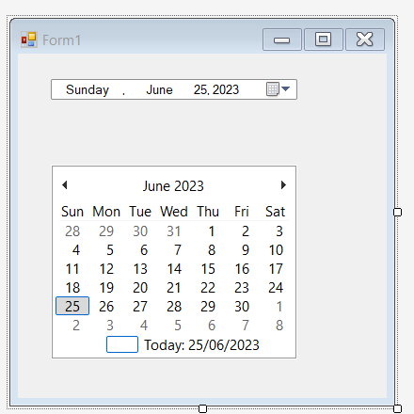
DateTimePicker & MonthCalendar
The DatePicker controls are used to display the date
DateTimePicker
MonthCalendar

Slide 26
DateTimePicker & MonthCalendar
Properties | Description
Name | Control name, usually starting with dtp
Format | How to display available dates
CustomFormat | Display date in user format
Value | Date value on control

Slide 27
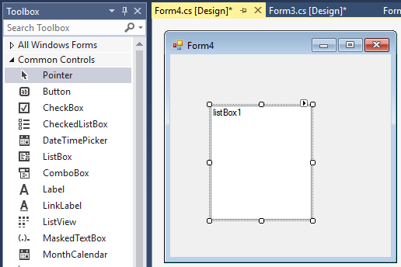
Listbox

Slide 28
Listbox
Listbox
ListBox creates a list for the user to choose from on the form. The ListBox has a default event of SelectedIndexChanged and has the following properties:
Properties | Description
Name | Listbox name, usually starting with lst
SelectionMode | How to choose in the list (select only one or allow multiple selection)
Items | Listbox elements
SelectedIndex | Returns the index of the selected item
SelectedIndices | Returns the set of indices of the selected items in the listbox
SelectedItem | Returns the selected item
SelectedItems | Returns the set of selected items
Items.Count | Returns the number of elements in the Listbox

Slide 29
Listbox
Important methods of lstABC.Items.MethodXYZ()
Where lstABC is the name of some Listbox, and MethodXYZ is listed below:
Methods | Description
Add | Add an element to the Listbox
AddRange | Add multiple elements to the Listbox
Remove | Remove an element from the Listbox
RemoveAt | Remove an element by position from Listbox
Clear | Remove all elements in Listbox
Insert | Insert an element into the Listbox
OfType | Filter out elements with the same data type

Slide 30
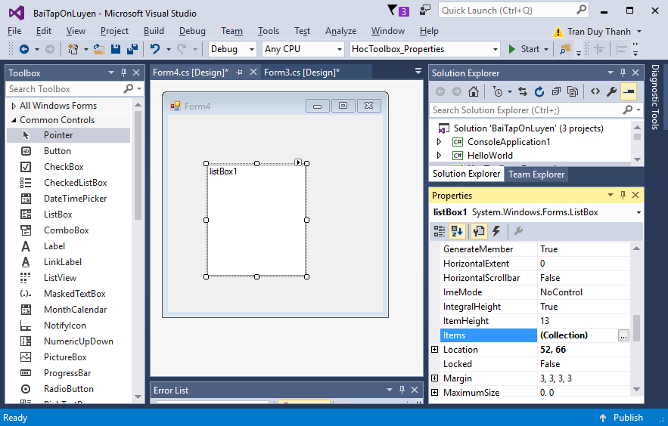
Listbox
Design Time data entry

Slide 31
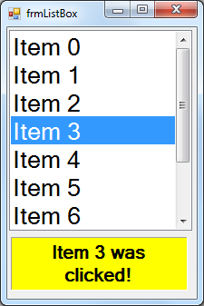
Listbox
private void
frmListBox_Load(object sender, EventArgs e)
{ listBox1.Items.Clear();
for (int i = 0; i < 10; i++)
listBox1.Items.Add("Item " + i);
}
private void listBox1_SelectedIndexChanged
(object sender, EventArgs e)
{
lblMessage.Text = listBox1.Text +" was clicked!";
}

Slide 32
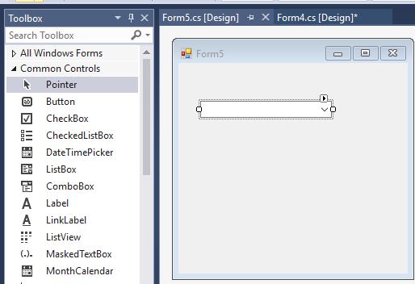
Combobox

Slide 33
Combobox
ComboBox also provides a list of options like a listbox, but is different in display and does not support selecting multiple items.
Properties | Description
Name | Combo box name, usually starting with cbo
Items | Elements in combo box
SelectedIndex | Returns the index of the selected item
SelectedItem | Returns the selected item
Items.Count | Returns the number of elements in combobox

Slide 34
Combobox
Important methods of cboABC.Items.MethodXYZ()
Where cboABC is the name of some Combobox, and MethodXYZ is listed below:
Methods | Description
Add | Add an element to the Combobox
AddRange | Add multiple elements to the Combobox
Remove | Remove an element from the Combobox
RemoveAt | Remove an element by position from Combobox
Clear | Remove all elements in Combobox
Insert | Insert an element into the Combobox
OfType | Filter out elements with the same data type

Slide 35
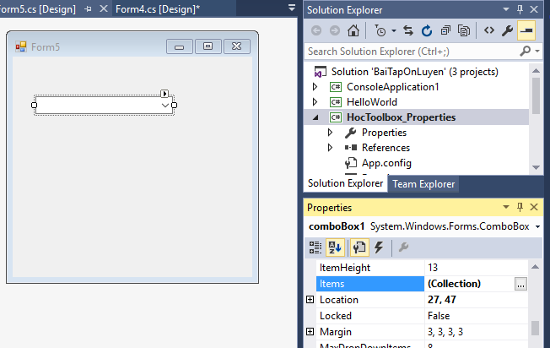
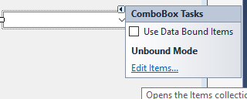
Combobox
Design Time data entry

Slide 36
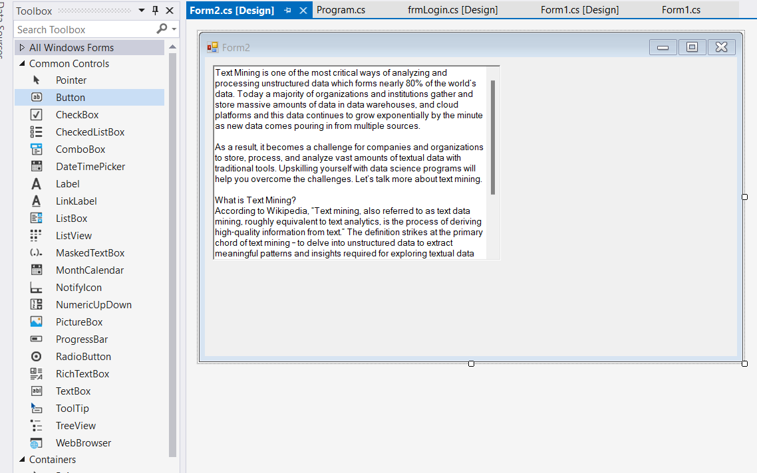
RichTextbox

Slide 37
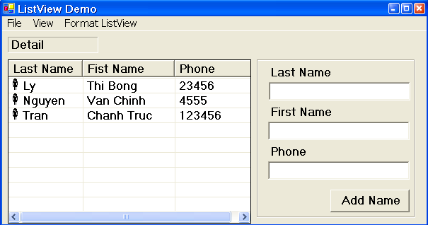
ListView
ListView is a control used to display data in a grid
Meaning of ListView
How to create ListView
Commonly used attributes
How to handle events on ListView
How to add data to ListView
How to delete ListView initialization data
How to edit data on ListView
How to group ListView

Slide 38
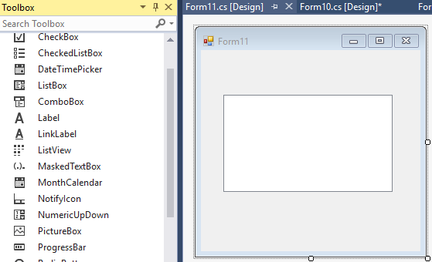
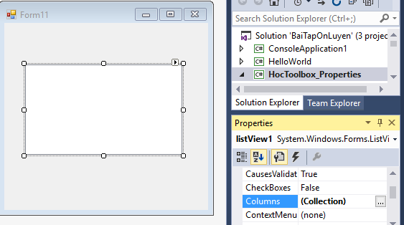
ListView
Columns property to create columns for ListView

Slide 39
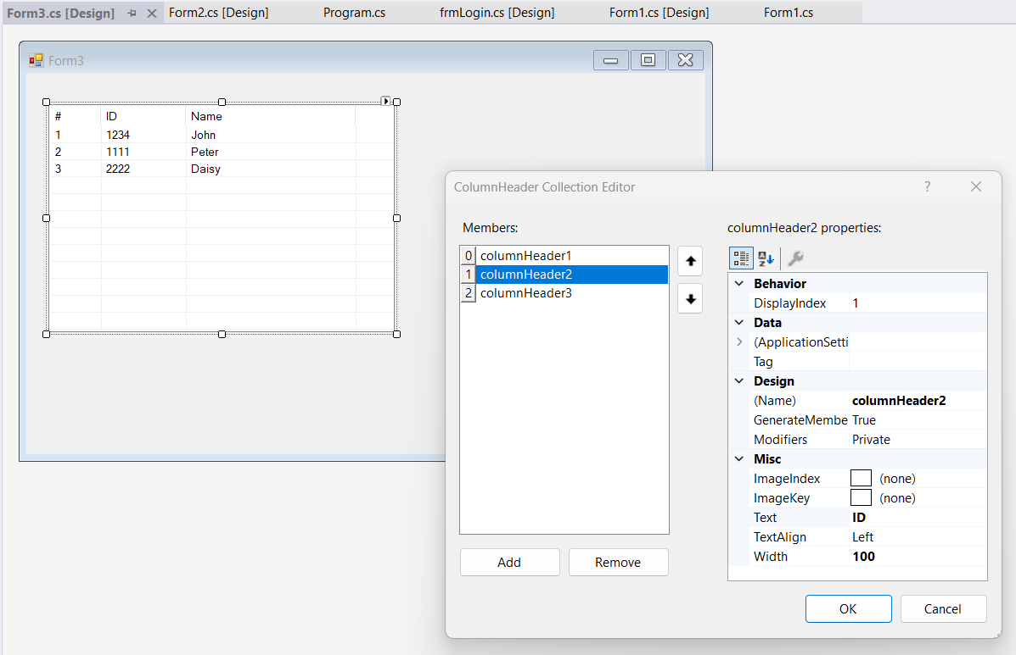
ListView

Slide 40
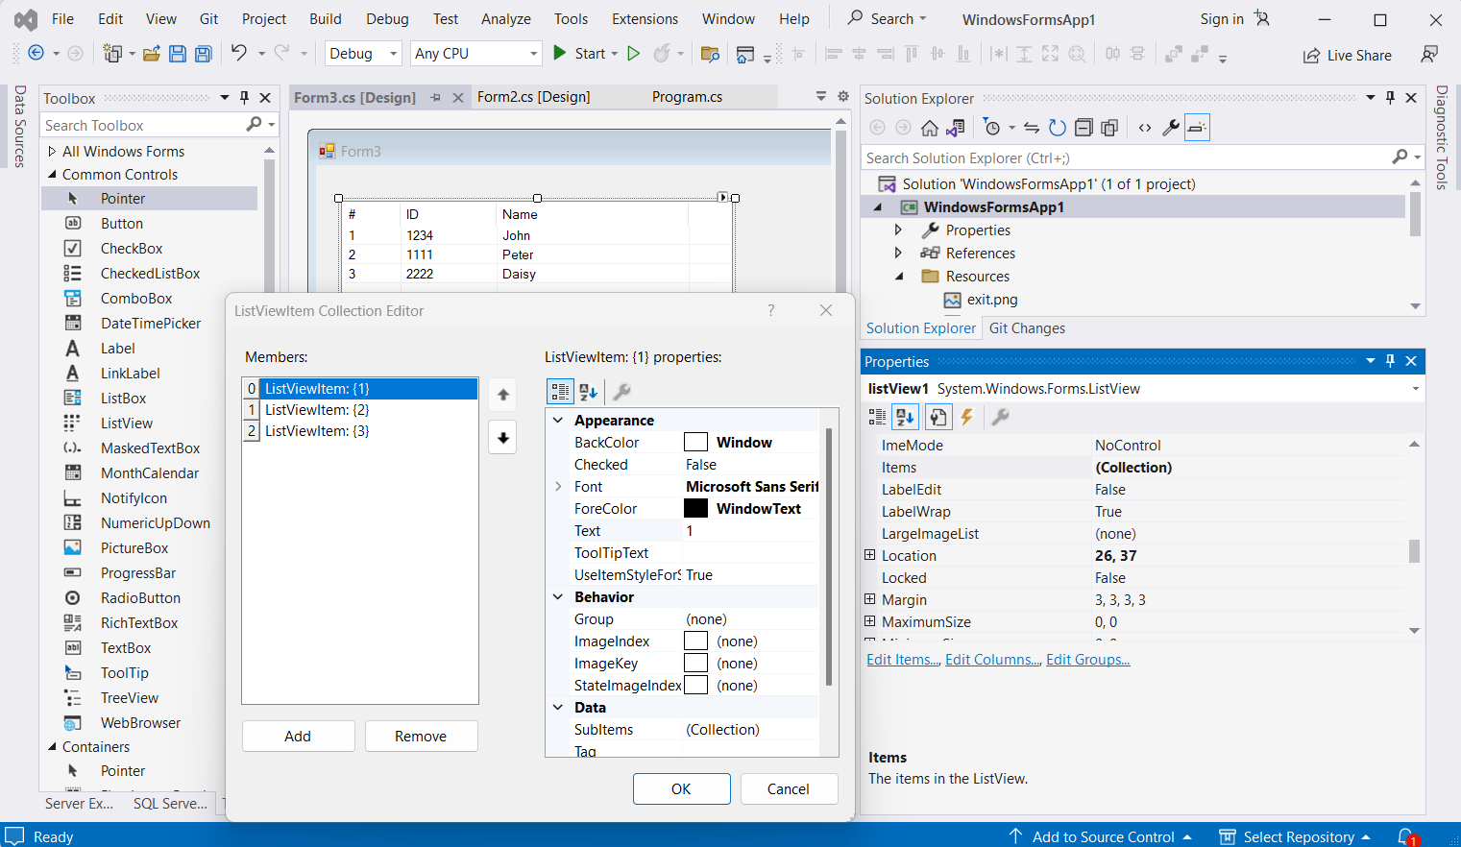
ListView

Slide 41
ListView
How to handle selecting event
private void listView1_SelectedIndexChanged(object sender, EventArgs e)
{
ListViewItem lvi = listView1.SelectedItems[0];
}
How to handle Column event
private void listView1_ColumnClick(object sender, ColumnClickEventArgs e)
{
if (e.Column == 0)
{
}
}

Slide 42
ListView
How to add data to ListView
ListViewItem lvi = new ListViewItem((listView1.Items.Count + 1) + "");
lvi.SubItems.Add("9999");
lvi.SubItems.Add("Blade");
listView1.Items.Add(lvi);
How to remove data from ListView
listView1.Items.RemoveAt(2);
listView1.Items.Remove(lviDelete);

Slide 43
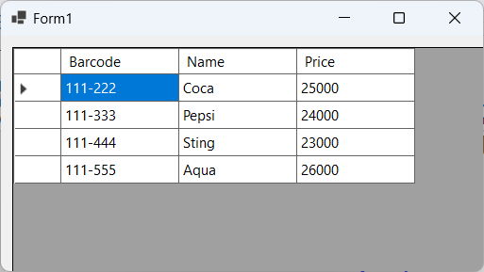
Meaning of DataGridView
DataGridView is similar to ListView used to display data on the interface with rows and columns
The special feature of DataGridView is that it can be displayed in a table from a database connection
Can display data in List as object

Slide 44
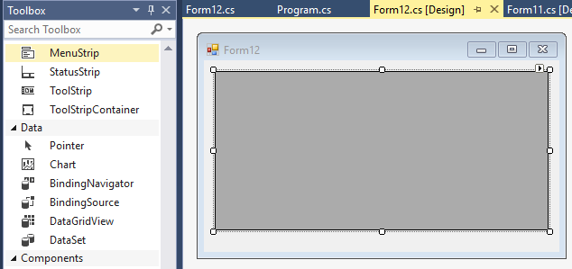
How to create DataGridView

Slide 45
How to display data on DataGridView
public class Product
{
public string Barcode { get; set; }
public string Name { get; set; }
public double Price { get; set; }
}

Slide 46
How to display data on DataGridView
List<Product> products = new List<Product>();
products.Add(new Product { Barcode = "111-222", Name = "Coca", Price = 25000 });
products.Add(new Product { Barcode = "111-333", Name = "Pepsi", Price = 24000 });
products.Add(new Product { Barcode = "111-444", Name = "Sting", Price = 23000 });
products.Add(new Product { Barcode = "111-555", Name = "Aqua", Price = 26000 });
dataGridView1.DataSource = products;

Slide 47
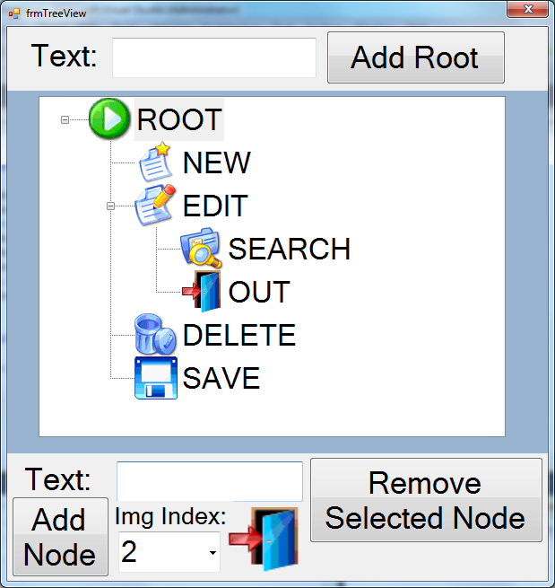
TreeView
Meaning of TreeView
How to create a TreeView
Commonly used attributes
How to display data on TreeView
Handle events on TreeView
How to delete Node on TreeView

Slide 48
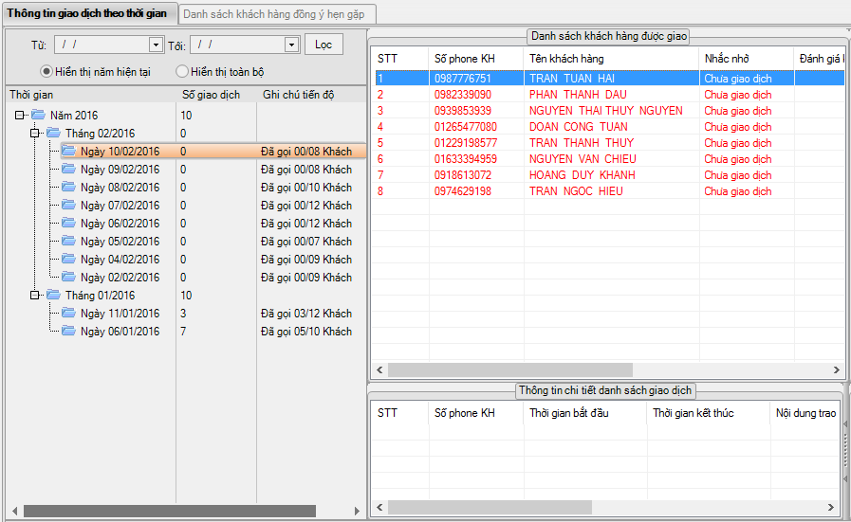
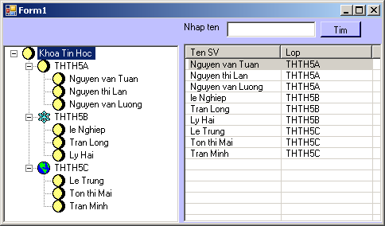
Meaning of TreeView
TreeView is a control used to display data in the form of a directory tree, making the data presentation highly visualized.

Slide 49
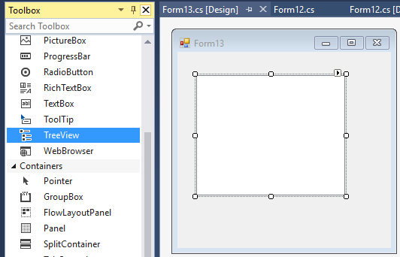
How to create a TreeView

Slide 50
Commonly used attributes
Name
ImageList
ImageIndex
SelectedImageIndex
TreeNode
SelectedNode
Add
Nodes
Expand
Collapse
Remove

Slide 51
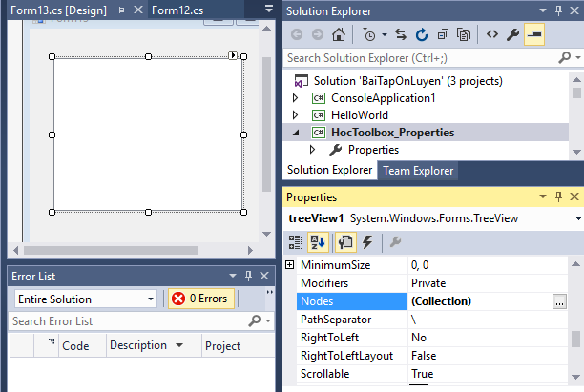
Commonly used attributes

Slide 52
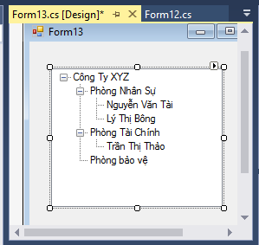
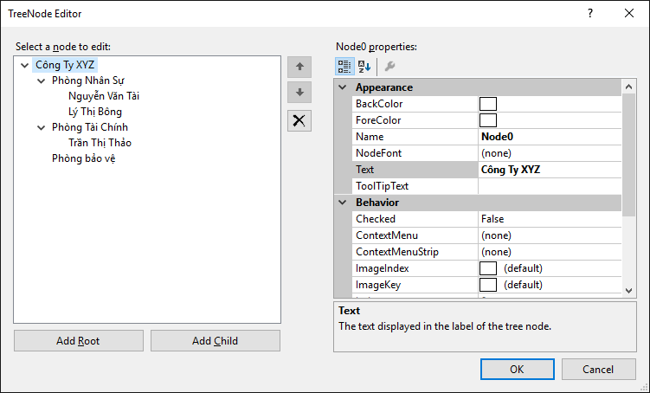
Commonly used attributes

Slide 53
How to display data on TreeView
tvSample.Nodes.Clear();
TreeNode rootNode = new TreeNode(txtRoot.Text);
rootNode.ImageIndex = 0
rootNode.SelectedImageIndex = rootNode.ImageIndex; tvSample.Nodes.Add(rootNode);

Slide 54
Handle events on TreeView
private void treeView1_AfterSelect(object sender, TreeViewEventArgs e)
{
if(e.Node!=null)
{
}
}
How to delete Node on TreeView
TreeNode tNode = tvSample.SelectedNode;
tvSample.Nodes.Remove(tNode);

Slide 55
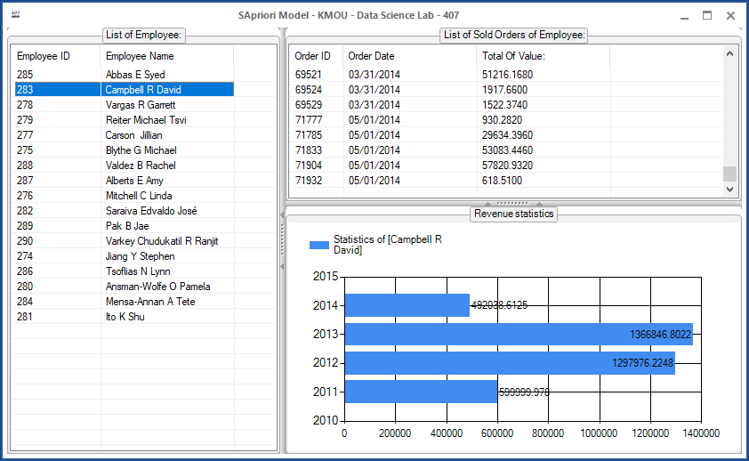
Chart

Slide 56
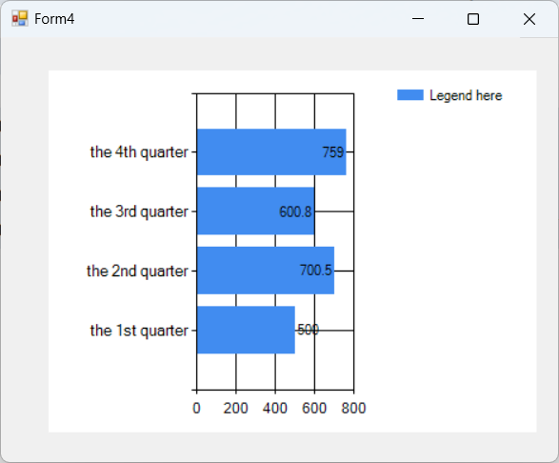
Chart
String[] Quaters = { "the 1st quarter", "the 2nd quarter", "the 3rd quarter", "the 4th quarter" };
double[] Y = { 500.0, 700.5, 600.8, 759 };
chart1.Series[0].LegendText = "Legend here";
chart1.Series[0].ChartType = SeriesChartType.Bar;
chart1.Series[0].IsValueShownAsLabel = true;
chart1.Series[0].Points.DataBindXY(Quaters, Y);

Slide 57
Câu hỏi ôn tập
Câu 1: Hãy đề xuất một mô hình máy học bất kỳ liên quan tới lĩnh vực kinh doanh bảo hiểm xe hơi.
Câu 2: Đề xuất cấu trúc dữ liệu liên quan tới lĩnh vực kinh doanh bảo hiểm xe hơi, hãy tạo lập một số dữ liệu để phục vụ cho mô hình máy học.
Câu 3: Trình bày kỹ thuật tích hợp mô hình máy học vào một hệ thống kinh doanh có sẵn.

Slide 58
Bài học tiếp theo
7.2. Giới thiệu công nghệ máy học ML.NET Framework
7.3. Sử dụng ML.NET Builder - no code low cost

Slide 59
THANK YOU!

